Slide 1
CREATING A WEB BROWSER
CAPSTONE PROJECT
PRESENTED BY
B. Vasanth kumar(192210399)
S. Ashwin Bharadwaj(192211683)

Slide 2
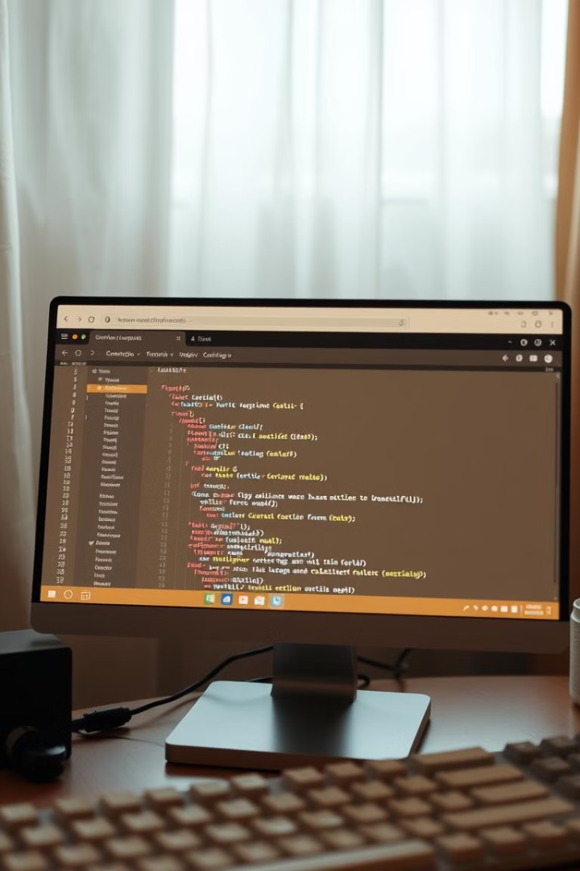
A C++ Web Browser: A Deep Dive
This presentation outlines the intricate process of crafting a web browser using C++ programming language. We delve into the fundamental functionalities, design choices, and underlying mechanisms that enable the creation of a modern, user-friendly web browser.
Developing a web browser in C++ presents a unique set of challenges and opportunities. C++'s power and performance make it an ideal choice for handling complex tasks, such as memory management, low-level network operations, and efficient rendering. This presentation explores these key aspects and showcases how C++ empowers developers to build robust and feature-rich web browsers.

Slide 3

Defining the Browser's Functionality
1
Navigation
2
Rendering
This includes functionalities for opening, closing, and navigating between web pages using URLs, forward and back buttons, and a history mechanism.
The browser should accurately render HTML and CSS, displaying web pages with all their elements, styles, and content.
3
Security
4
User Experience
Ensure secure web browsing with HTTPS support, authentication, and protection against malicious websites and scripts.
The browser should be intuitive and easy to use with features like bookmarks, tab management, and extensions for enhanced functionality.

Slide 4
User Interface Design
Layout
Navigation Controls
Address Bar
The UI should prioritize a clear separation between navigation controls, the address bar, and the web page display area.
Include buttons for back, forward, refresh, home, and possibly favorites.
The address bar allows the user to enter URLs and should provide auto-completion and URL validation features.

Slide 5
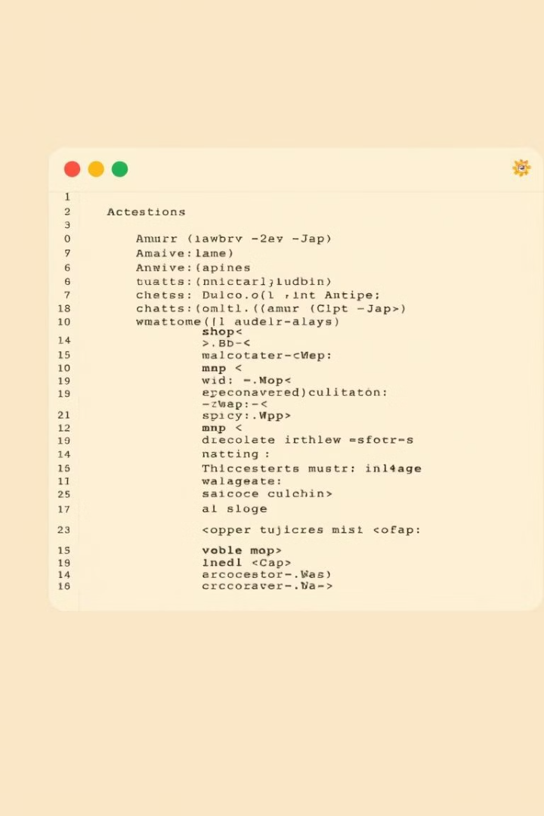
Parsing HTML and CSS
1
HTML Parsing
The browser reads the HTML source code and creates a Document Object Model (DOM) tree, representing the structure and content of the webpage.
2
CSS Parsing
The browser reads the CSS code and applies the styles to the DOM elements, defining their appearance and layout.
3
Rendering
The browser combines the DOM and CSS styles to render the webpage visually, displaying it in the browser window.

Slide 6
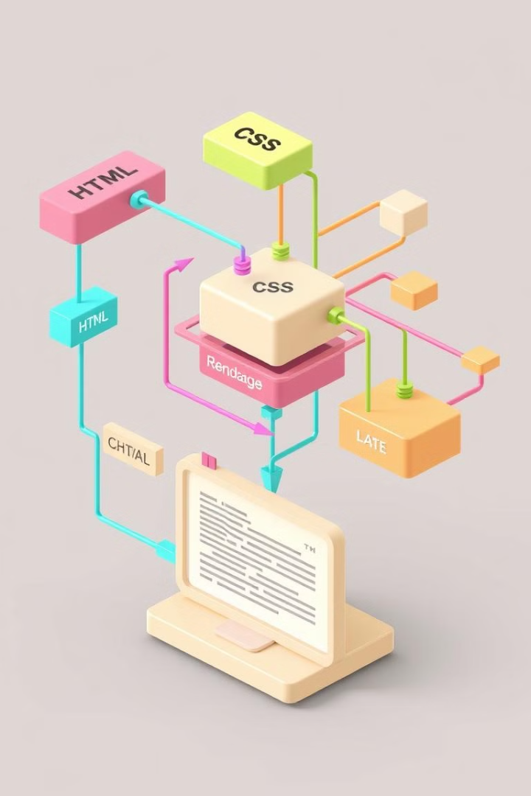



Implementing the Rendering Engine
Layout
The rendering engine determines the layout of the web page, placing elements on the screen based on their position, size, and CSS properties.
Painting
The rendering engine paints each element onto the screen, applying colors, fonts, and images according to the CSS styles.
Compositing
The rendering engine combines the individual elements into a complete image, creating the final display of the webpage.

Slide 7

Key Components and Functionality
1
Rendering Engine
2
Network Stack
This component parses HTML, CSS, and JavaScript to display webpages accurately.
It handles communication with web servers to fetch the required resources for webpages.
3
Memory Management
4
User Interface
C++ allows for careful allocation and deallocation of memory, ensuring efficient resource usage.
This provides the interface for user interaction, including the address bar, tabs, and navigation controls.

Slide 8
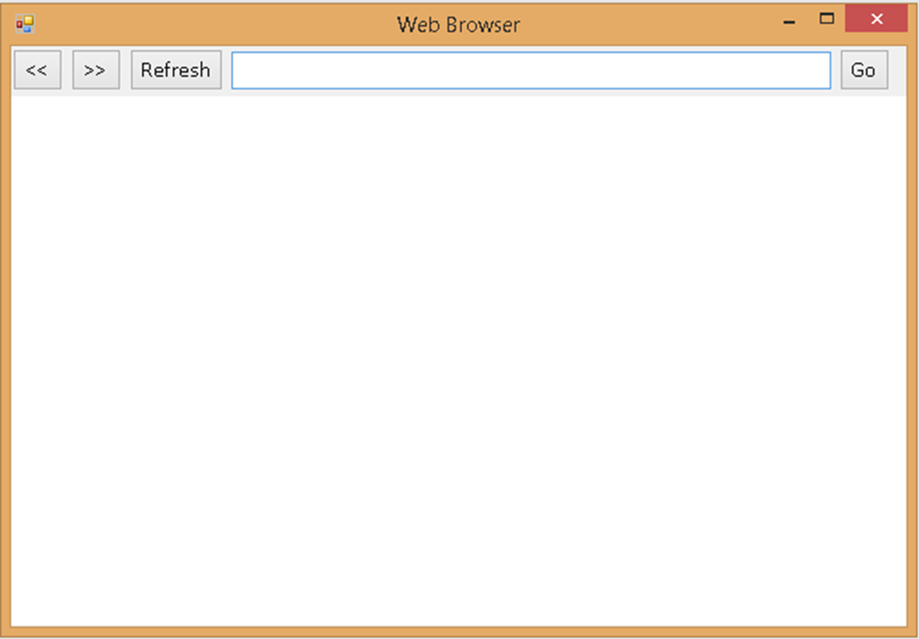
WEB BROWSER

Slide 9

Handling User Interactions
Mouse Events
Keyboard Events
The browser responds to mouse clicks, double-clicks, hover events, and scrolling actions.
The browser handles key presses for navigation, typing in input fields, and other interactive elements.
DOM Manipulation
User interactions can modify the DOM, leading to changes in the layout, content, and appearance of the webpage.

Slide 10

Integrating with a Search Engine
Search Engine
API
Protocol
Data Format
Google Custom Search Engine API
RESTful API
Google
JSON
RESTful API
Bing
JSON
Bing Search API
RESTful API
DuckDuckGo
JSON
DuckDuckGo Instant Answer API
The integration process involves sending a search query to the chosen search engine's API. The API returns the results in JSON format. These results can be parsed and displayed within the browser's search results page.

Slide 11




Networking and Data Retrieval
HTTP Protocol
The browser uses the HTTP protocol to communicate with web servers, requesting and retrieving web pages, images, and other resources.
Sockets
The browser uses sockets to establish connections with web servers and send and receive data over the internet.
Caching
The browser caches frequently accessed resources to improve loading speeds and reduce network traffic.

Slide 12





Pseudocode for Search Engine Integration
User Input
Capture the search query entered by the user in the address bar.
Search Engine API
Construct the URL to the chosen search engine API, incorporating the user's search query.
Network Request
Send a network request to the search engine API using the constructed URL.
Results Parsing
Parse the search results received from the API into a suitable format for display.
Display Results
Render the parsed results on the web browser, typically in a list format.

Slide 13

Error Handling and Debugging
1
2
3
Error Handling
Debugging Tools
Logging
The browser should gracefully handle errors such as invalid URLs, network failures, and script errors, displaying informative messages to the user.
The browser should provide tools for developers to inspect the DOM, network activity, and console logs to identify and fix errors.
The browser can log events and errors to a file or to the console, aiding in debugging and troubleshooting.

Slide 14


Conclusion and Future Enhancements
Multimedia Support
Integrated Tools
The browser can support various multimedia formats, including video, audio, and interactive content. This enables users to enjoy a rich and engaging web browsing experience, enhancing the visual and auditory elements of web pages. The browser could seamlessly play back videos in various formats, such as MP4 and WebM, while providing controls for volume, playback speed, and full-screen viewing. It could also support a range of audio formats, including MP3 and AAC, allowing users to listen to music, podcasts, or other audio content directly within the browser.
The browser could incorporate essential tools for enhancing user productivity and convenience. For instance, the browser could include a built-in image editor for basic image manipulation tasks, such as resizing, cropping, and applying filters. Additionally, the browser could offer a screenshot tool, allowing users to capture images of web pages or specific elements for sharing or reference purposes. To enhance security and streamline password management, the browser could incorporate a password manager that securely stores and auto-fills user credentials, eliminating the need to remember multiple passwords.

